Slide 1
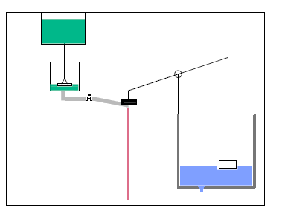
Chemical Dose Controller (CDC) Simplification
MIC | Project | Presentations Fall 2017
MIC | Project | Presentations Fall 2017
Notes:
In order to achieve easier operation for operators and better performance for water treatment facilities.

Slide 2
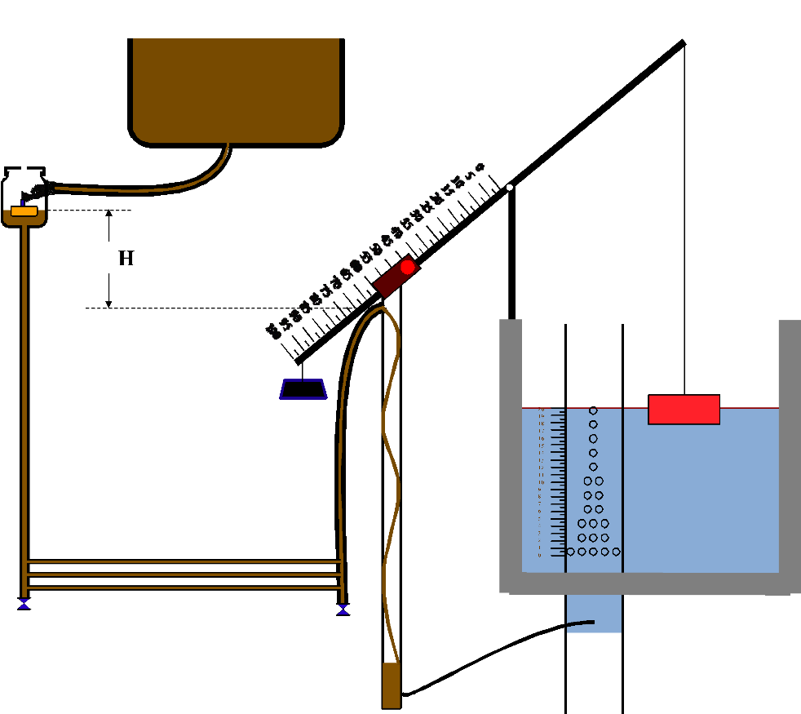
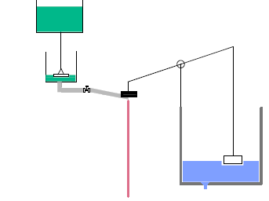
Introduction
Goal:
easier operation
easier fabrication
Simplification
MIC | Project | Presentations Fall 2017
MIC | Project | Presentations Fall 2017
Notes:
substitute CDC slider part with a single valve
replace the LFOM with a hole at the bottom
equal-length lever

Slide 3
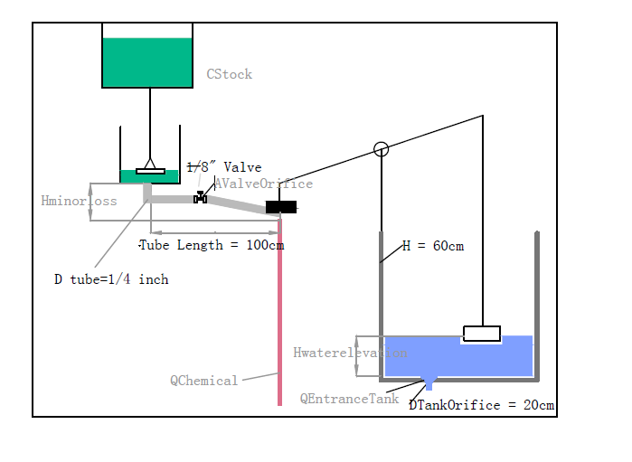
2-D Layout
MIC | Project | Presentations Fall 2017
MIC | Project | Presentations Fall 2017
Notes:
mark our variables

Slide 4
3-D Layout
MIC | Project | Presentations Fall 2017
MIC | Project | Presentations Fall 2017

Slide 5
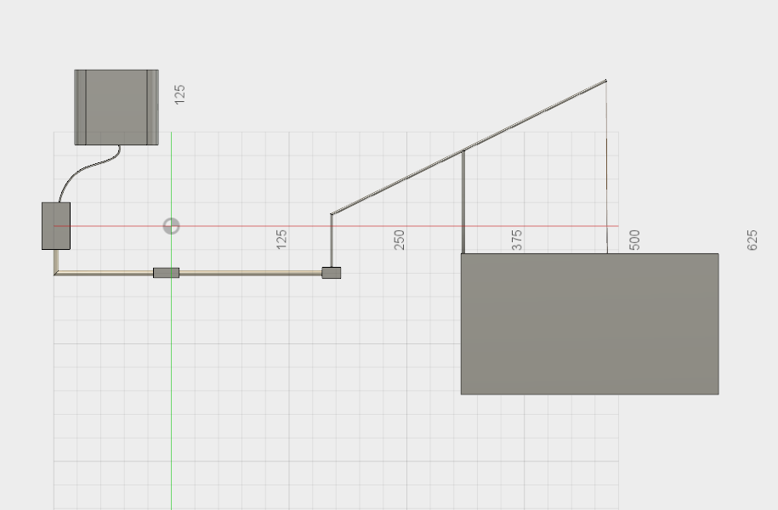
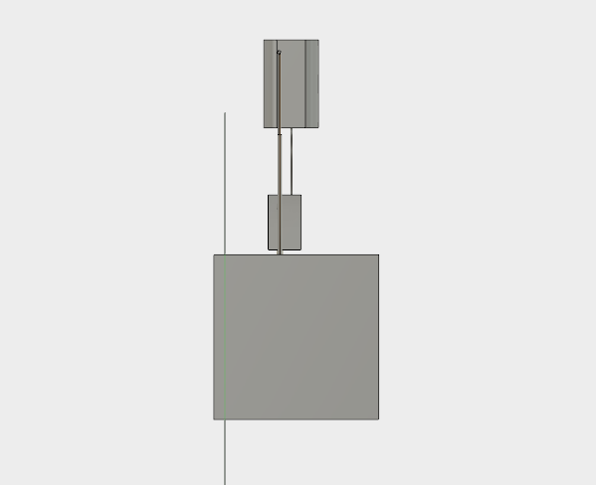
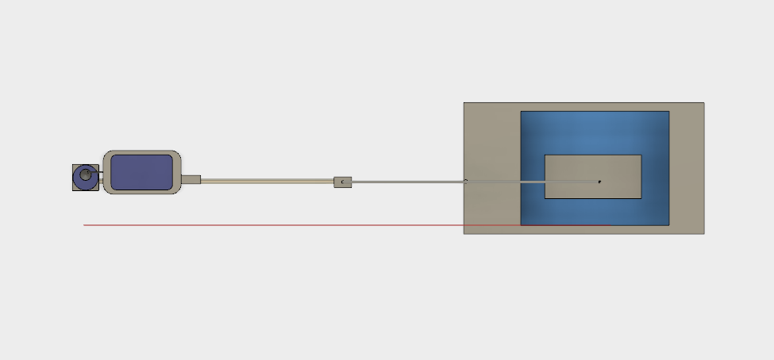
Figure3: Front
Figure5: Right
Figure4: Top
MIC | Project | Presentations Fall 2017

Slide 6
Valve & Reducer
MIC | Project | Presentations Fall 2017
MIC | Project | Presentations Fall 2017

Slide 7
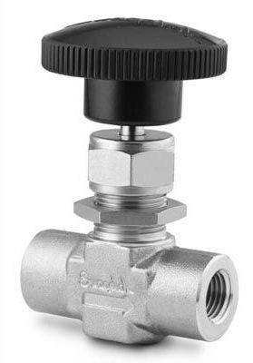
Valve Requirement
1. Manual operation
2. Small orifice size
3. Chlorine resistance
4. Precise flow control
MIC | Project | Presentations Fall 2017
MIC | Project | Presentations Fall 2017
Notes:
read the Chlorine

Slide 8
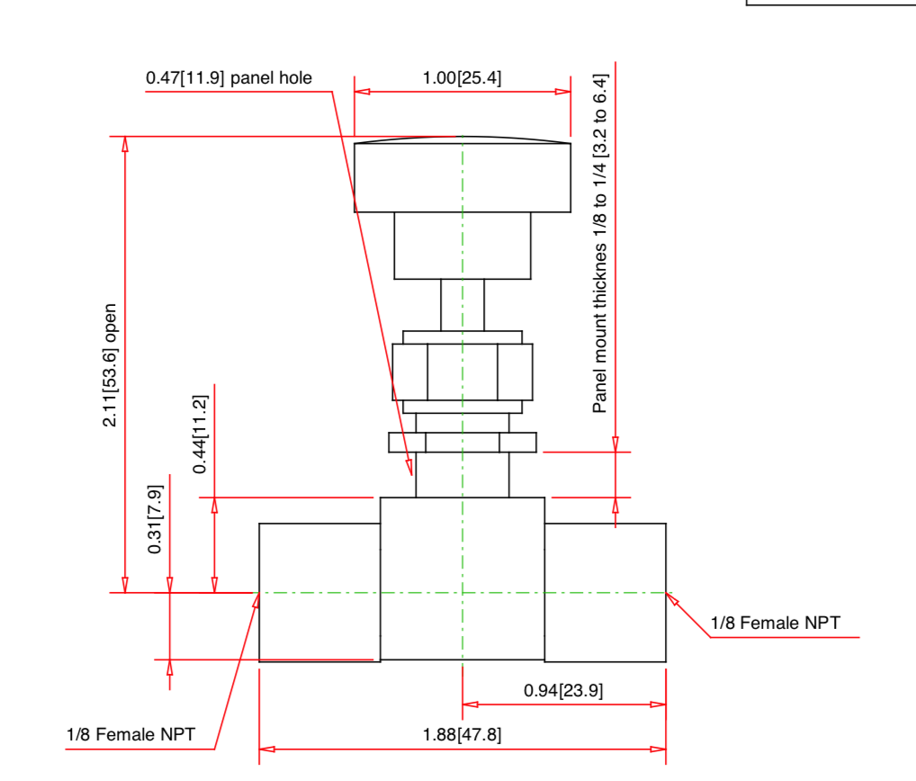
Product Available - Valve
Material:316
stainless steel
Type:
Needle Valve
Tube Size: 1/8
MIC | Project | Presentations Fall 2017
MIC | Project | Presentations Fall 2017

Slide 9
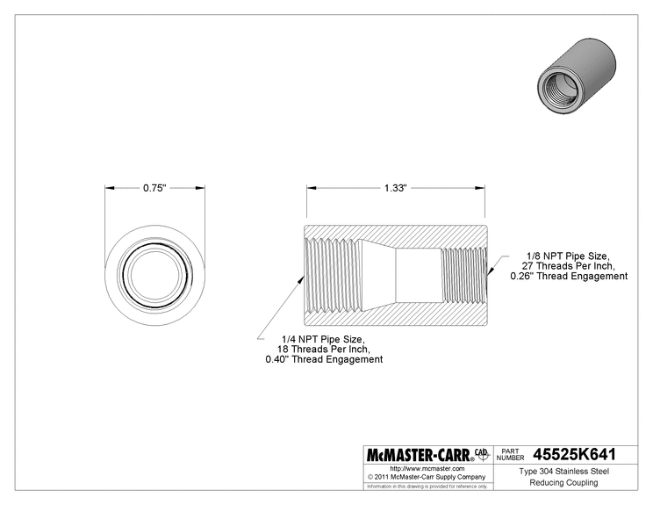
Product Available - Reducer
Material:304
stainless steel
Type:
straight reducer
Fitting Size:
1/8 to 1/4
MIC | Project | Presentations Fall 2017
MIC | Project | Presentations Fall 2017

Slide 10
Theoretical Basis
MIC | Project | Presentations Fall 2017
MIC | Project | Presentations Fall 2017

Slide 11


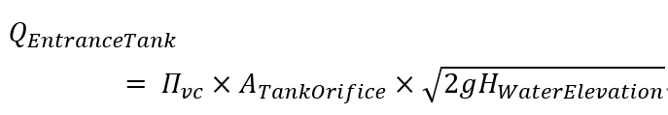
Entrance Tank Flow Rate
Tank Orifice
Vena contracta
MIC | Project | Presentations Fall 2017
MIC | Project | Presentations Fall 2017

Slide 12





Head Loss due to Expansion
A_ValveOrifice
A_in
A_out
V_out
Based on equations above, we can derive the V_out expression with tube and valve orifice cross sectional area and minor loss
MIC | Project | Presentations Fall 2017

Slide 13



Chemical Flow Rate vs. Entrance Tank Flow Rate
By using the equal-length lever, we make the water elevation equal to total head loss of our chemical dosing system and since we assume all head loss in this system is minor loss, we derived these formula:
MIC | Project | Presentations Fall 2017
MIC | Project | Presentations Fall 2017

Slide 14
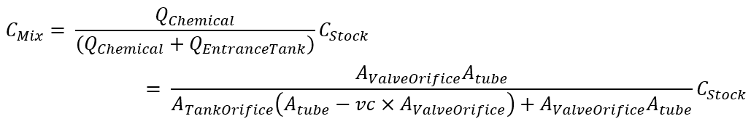
Expression of mixing concentration
Based on mass balance, chemical stock concentration and the flow rate relationship we developed in previous slide, we can derive an expression for the chemical concentration after mixing.
MIC | Project | Presentations Fall 2017
MIC | Project | Presentations Fall 2017
Notes:
No flow rate is found in this equation, only the changes in valve orifice could change the chemical concentration after mixing.

Slide 15
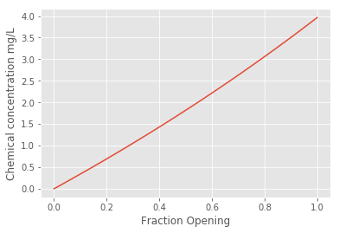
Mixing Concentration vs. Fractional Opening
MIC | Project | Presentations Fall 2017
MIC | Project | Presentations Fall 2017

Slide 16

Assumption
Minor loss dominant
Laminar flow
Same vena contracta on both sides.
Submergence depth change of the float negligible.
MIC | Project | Presentations Fall 2017
Notes:
First, we assume the chemical solution from constant head to the lever is dominated by minor loss caused by the valve. And we also assume the minor loss only happens at the valve, there's no other minor loss along the tube.
Second, we assume the vena contracta is the same for both tube and tank.
Third, we assume the surface area of the float is large enough to make the submergence depth change of the float negligible.
Fourth, we assume the flow is laminar, so that the friction factor will be relatively small

Slide 17
Error Analysis
MIC | Project | Presentations Fall 2017
MIC | Project | Presentations Fall 2017

Slide 18



Taking Major Loss into account
Based on these, we could check the reliability of our design, which depends both the water elevation in entrance tank and the fractional opening of the valve.
We just use the fractional opening where we expected to have 2mg/L chemical concentration after mixing as an example.
MIC | Project | Presentations Fall 2017
MIC | Project | Presentations Fall 2017
Notes:
Assume laminar flow to avoid sudden increasing friction factor

Slide 19
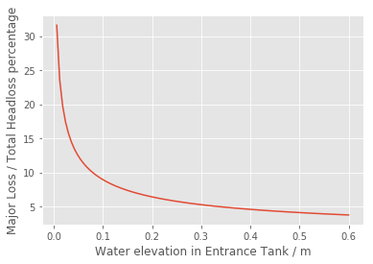
Example – 2mg/L
MIC | Project | Presentations Fall 2017

Slide 20
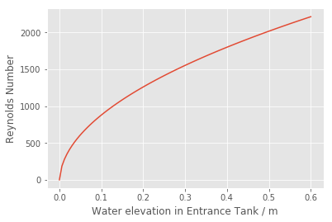
Example – 2mg/L
At our target working flow rate
MIC | Project | Presentations Fall 2017

Slide 21
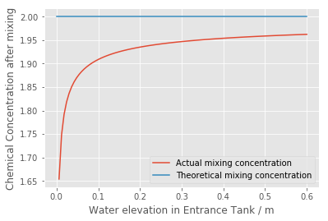
Example – 2mg/L
MIC | Project | Presentations Fall 2017

Slide 22
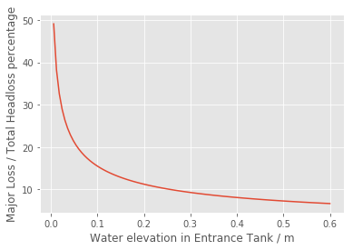
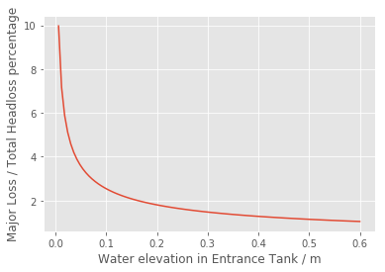
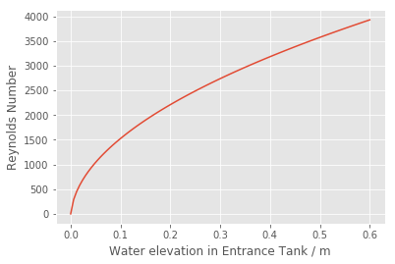
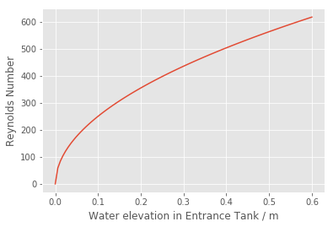
Adjusting the fractional opening
Increasing Fractional Opening
Decreasing Fractional Opening
MIC | Project | Presentations Fall 2017
Notes:
More reliable to work at high flow rate, low chemical dosing requirement

Slide 23
Pros and Cons
MIC | Project | Presentations Fall 2017

Slide 24
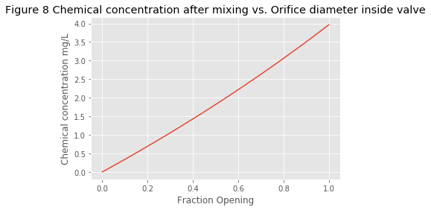
Pros
Simplified Operation
Accurate flow control
Wider chlorine dosing range
(0-4 mg/L vs. 0-2 mg/L)
Longer drain time (14 hours vs. 12 hours)
Major loss ≤ 10 % Total Head Loss
Linear relationship between fractional
opening and mixing concentration
MIC | Project | Presentations Fall 2017
Notes:
Compared to the previous CDC system,
First, our system gets rid of the LFOM, slider and the long dosing tubes. With a single valve, the construction and operation of the system would be simplier. Also, the entrance tank flow rate will be more accurate compared with current design using LFOM.
Second, the drain time of our storage tank is near 14 hours, which means operators can fill less frequently. This is because we use a more concentrated solution to reduce the flow and prevent the flow changes from laminar to turbulent
Third,our system can provide a wider but proper concentration range after mixing. Using the parameters we designed, it could offer concentration ranges from 0 to 4 mg/L of chlorination, which means our design can achieve a wider mixing concentration range and can achieve the upper limit for chlorine dose(4mg/L).The current Agua Clara design can only reaches a maximum of 2 mg/L concentration after mixing. And since we do not have slider or LFOM to disturb the result, this system should be more reliable compared with system driven by major loss.
Fourth, major loss only takes up less than 10% of total headloss when the system is operating at its designated work flow rate, thus, this system is quite reliable.
Fifth, our system shows a linear relationship between fractional opening of the valve and the mixing concentration, which is easier for operation.

Slide 25
Constraints
Not suitable for low flow rate raw water
Bad performance when water level is low
Reynolds number < 2300
MIC | Project | Presentations Fall 2017
Notes:
First, this new chemical dosing controller cannot be designed to treat low maximum flow rate, such as 1L/s. Since the height of the tank should be within 1 meter so that operators won't have any difficulties in monitoring the raw water inside the tank, the diameter of the orifice at the bottom of the tank will sharply decrease as the flow rate decrease. Given the same dosing tube, valve and chemical concentration in storage tank, a little change in valve diameter can incredibly increase the chemical concentration after mixing to be around 100 mg/L. Or, we have to use more clean water to dilute the chemical concentration, which decreases the efficiency of the treatment. Thus, the tank should be designed to handle high flow rate raw water.
Second, when water depth inside the tank is reduced to a low level, we cannot make sure the flow rate could conform to the formula we used to calculate, since when water level is low, part of water may tend to stay quiescent but not flow through the orifice at the bottom,thus, the new system should avoid the water level is too low. Moreover, major loss percentage is increasing sharply when raw water level is too low, so this system should avoid treating raw water less than 10 cm deep.
Third, since we need a laminar flow to reduce the importance of major loss, the Reynolds number also limit the orifice diameter of the valve, once we make it larger, the Reynolds number for high raw water flow rate will result in a larger value than the 2300 laminar limit. Otherwise, the friction factor can increase sharply when the flow turns from laminar to turbulent.At that moment, our flow won't stay constant as plant flow rate increases and the performance will be far away from our theoretical expectation.

Slide 26
What we learned
According to our practice, we know how to build reliability into our system.
Know how to improve accuracy of our system.
Consider the range of plant flow rates in the design.
Learn more about Fusion 360!
…...
MIC | Project | Presentations Fall 2017

Slide 27
Future work
MIC | Project | Presentations Fall 2017

Slide 28
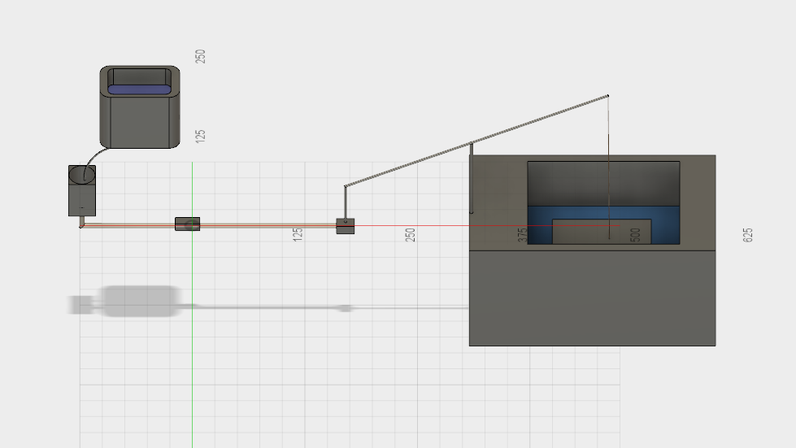
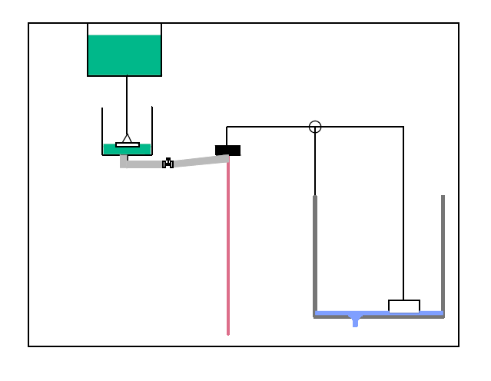
A practicable system of this model has to be built to ensure all our proposal for this new system is correct.
This system could further be adjusted to be able work with a maximum 1L/s raw water treatment target.
MIC | Project | Presentations Fall 2017
Notes:
Our system is just based on calculation now, at least a

Slide 29
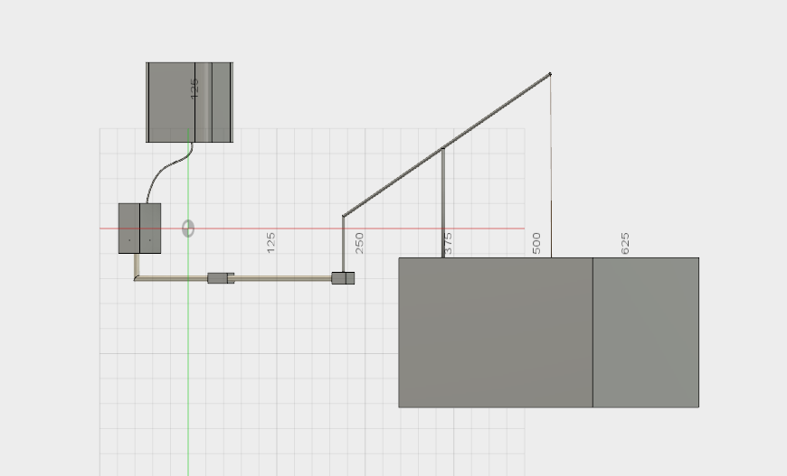
We need further experiments to draw scale on the knob of the valve to help the operator adjust the mixing concentration. And also find range of plant flow rate that our new design shows more reliable performance than current CDC system.
We need some experiment to see the severity of blockage inside the valve and found a method to solve it.
MIC | Project | Presentations Fall 2017
Notes:
Current CDC system is suffering from blockage due to calcium carbonate formed as calcium hypochloride react with carbon dioxide, and its performance is decreaseing with time. Our design, though uses 1/4 inch tube to get rid of such problem in tubes, may stil suffer similar blockage inside the valve, and since the opening of our valve is often smaller compared with dosing tube used, it may result in more serious problem.

Slide 30

Questions
and
Recommendations
Lingzi Xia
M.s Env. Engineering
lx236@cornell.edu
Simiao Wang
M.s Env. Engineering
sw939@cornell.edu
Yuhao Du
M.Eng Env. Engineering
yd342@cornell.edu
Yingge Wang
M.Eng Env. Engineering
yw895@cornell.edu
MIC | Project | Presentations Fall 2017

